Slide 1
Farm-level data sharing : Evaluating the potential of the DPP & EBW to build trust
AGRI.A4 Data Governance Unit
Spring 2026

Slide 2
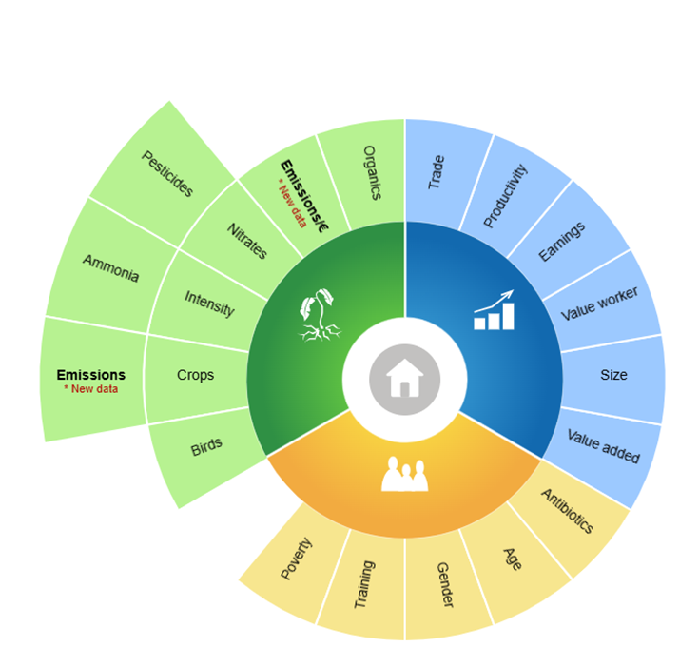
The farming community has shown readiness to participate in sustainability reporting
Such data is essential to demonstrate progress on climate, biodiversity, and food system resilience, while also enabling farmers to prove the value of their sustainability efforts in the market.
The farming community has shown readiness to participate in sustainability reporting, as reflected in ongoing work on the Farm Sustainability Compass on a voluntary basis
Source: European Commission | Agri Sustainability Compass

Slide 3
However, farmers have raised clear concerns regarding the use of their data.
Loss of control
and privacy
Fear that third parties might use their data without consent and misuse sensitive farm data.
Lack of transparency
Uncertainty about who can access information and for what purpose.
Administrative burden
The risk of duplicative or overly complex reporting requirements.

Slide 4

Leveraging corporate solutions : EBW & DPP
DPP
EBW versus wallet for natural persons
User controls what to share
B2G communication channel to reduce multiple reporting burden
Privacy-preserving & selective disclosure
Ecosystem adoption & wallet management needed
Full lifecycle traceability of products
Supports circular economy & compliance
Complex supply chain integration
> USER-CENTRIC
> ISSUER-CENTRIC
> BEST FOR: IDENTITY MANAGEMENT, PRIVACY & CONTROL
> BEST FOR: TRANSPARENCY & DATA LIFECYCLE

Slide 5

European Business Wallet
Intended to simplify and digitalise reporting obligations by reducing administrative burdens, phasing out outdated paper-based requirements, and promoting digital-by-default, interoperable solutions
Strategic catalyst to promote interoperability and enhancing legal certainty, reducing compliance costs, and supporting competitiveness and innovation
Interest from agricultural sector:
https://www.webuildconsortium.eu/ - LSP funded by CNECT.H4 regarding data sharing & identify management through https://ceads.eu/
EDIC on Agrifood

Slide 6
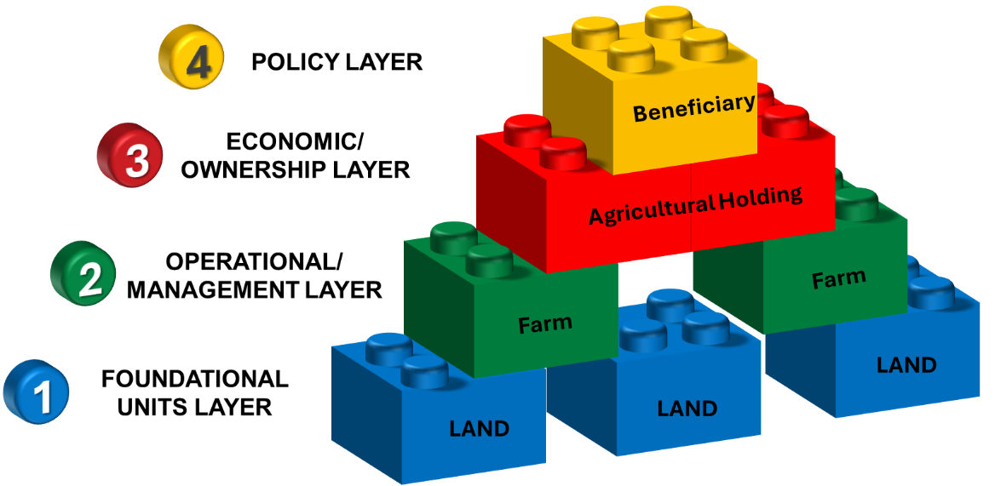
How to identify a farm ?

Slide 7
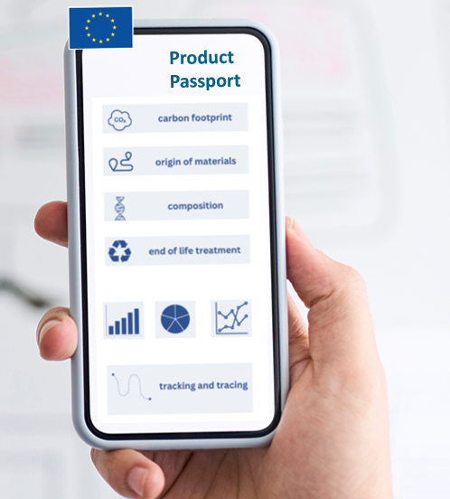
Digital Product Passport
DPP’s original legal basis can be found in the Ecodesign for Sustainable Products Regulation (ESPR)
It will be complemented through product specific delegated acts (textiles, steel and aluminium, tyres, furniture, ICT, energy related products...) and other EU Regulations/Directives may include DPP provisions
Interest from agricultural sector from a voluntary perspective:
NL setting up a pilot with the ministry of agriculture, food safety agency and GS1
https://aatp.foodagility.com/

Slide 8
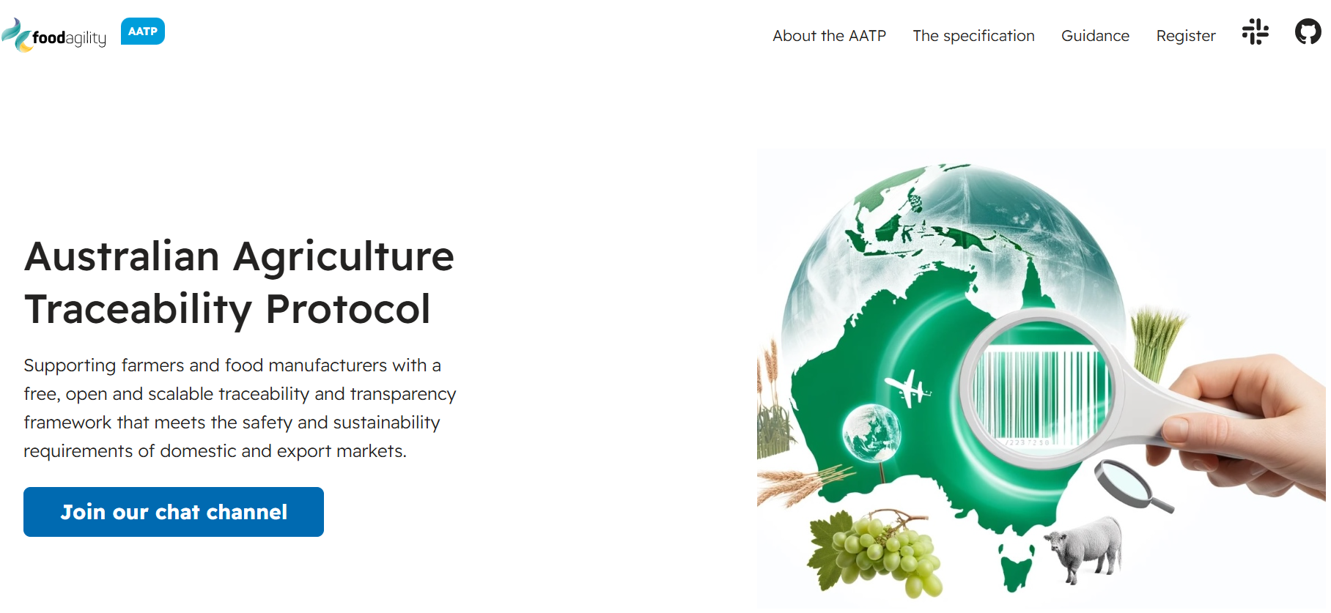

Slide 9
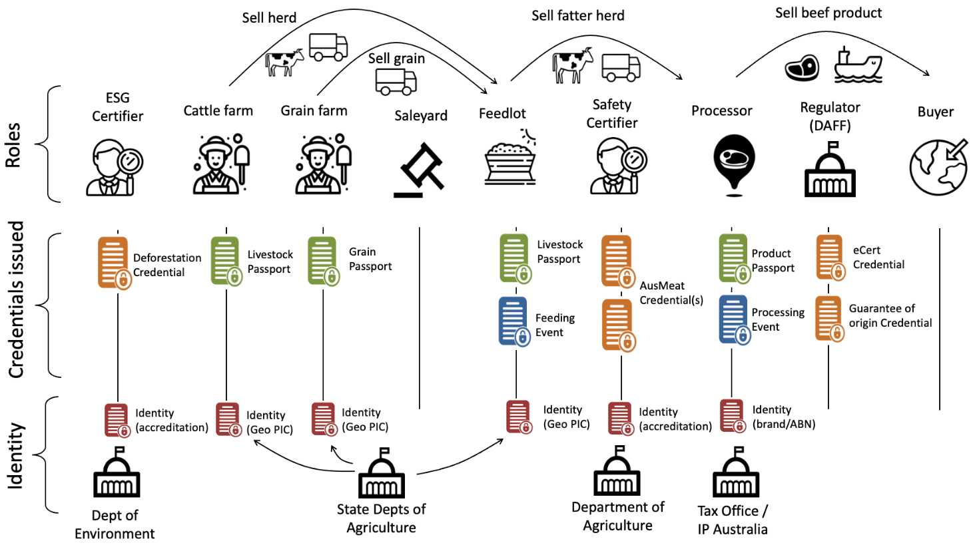

Slide 10
Next steps
Synergies across projects and communities
Ensure exchange of views and of expertise across various project and initiatives (CEADS, Agrifood EDIC, Partnership of Agricultural Data etc)
Coalition of the willing
Bring together MS ready to experiment and showcase how cross-border interoperability can be tackled
Piloting
Identify relevant business cases where the added value can be easily showcased

