Slide 1

LBLOD
Daan Zwaenepoel
20/04/2026

Slide 2
300 Local Authorities — A Wealth of Information in Decision Making
t
City of Hasselt
Conditions for building permits
t
City of Ghent
New plan on traffic circulation
t
City of Mechelen
Tax on business space

Slide 3
Relevant to Governments
, Civilians
& Companies
But the information is locked away in non-transparent archives. Can we change that?
We are building an ecosystem based on standards & linked open data!

Slide 4
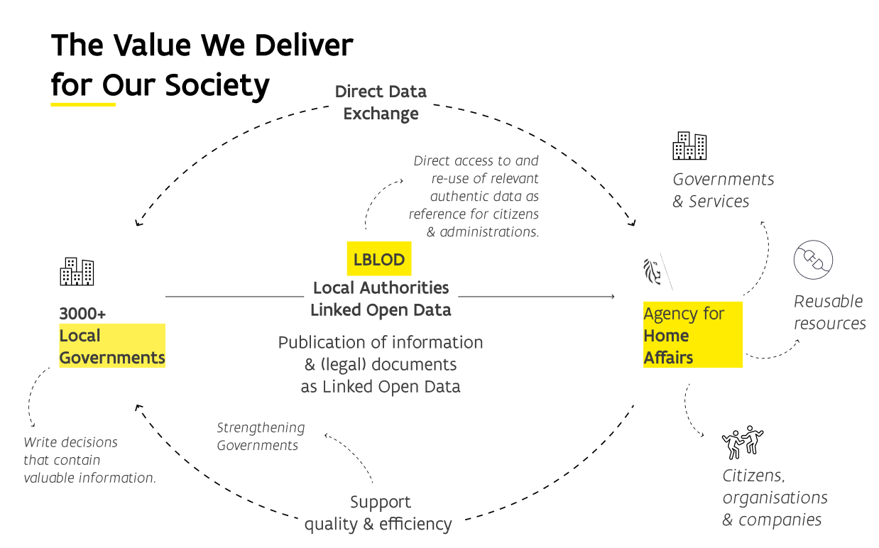

Slide 5
Re-use of local data in practice

Slide 6
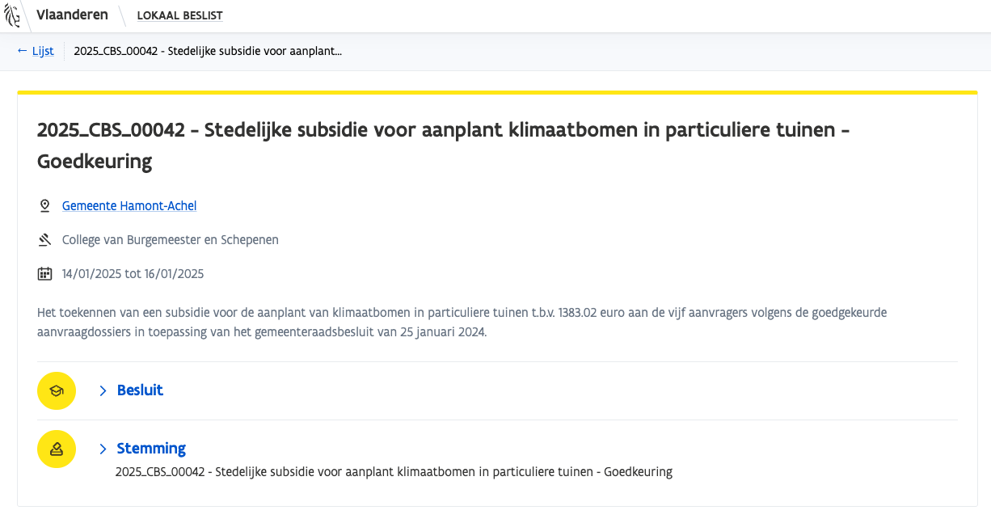
Lokaal beslist
Local Authorities make decisions with the same Linked Open Data Standard
DEMO

Slide 7
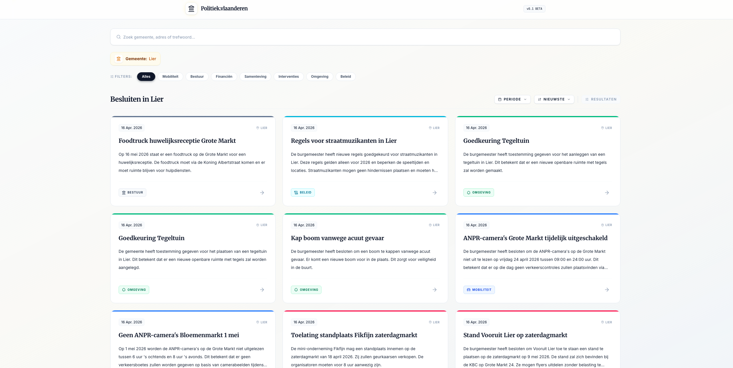
Re-use by citizens
Politiek.Vlaanderen Is an open-source project created by a citizen who is working with LBLOD data
DEMO

Slide 8
But wait there is more

Slide 9

DECIDe
Data driven Exploration in Contextual Information on (local) Decisions
How can sharing and (re)using local decisiondata make life easier for everyone?

Slide 10






Partners
Agentschap Binnenlands Bestuur
City of Ghent
City of Freiburg
City of Bamberg
Urban Software Institute
University of Applied Sciences Kehl
University of Jena

Slide 11
4 usecases within the project
Basic set up data space
UC0
Policy impact report
UC0.1
Mapping LD&L on restricted mobility zones to geo-locations
UC1
SMART SEARCH
UC2
AI supported solutions

Slide 12
Basic set up data space
UC0

Slide 13
Conversion & integration pipelines for LD&L to ELI
Flanders
LD&L = RDFa OSLO
(Flemish LOD standard)
Ghent
Mapping
DATA PROVIDER
LD&L as ELI + Named entity recognition +linking
(European LOD standard)
Mapping
Freiburg
LD&L = Oparl JSON-API
(German standard)
Scraping AI
Bamberg
LD&L = PDF/HTML
(no standard)

Slide 14
Policy impact report
UC0.1

Slide 15


Slide 16
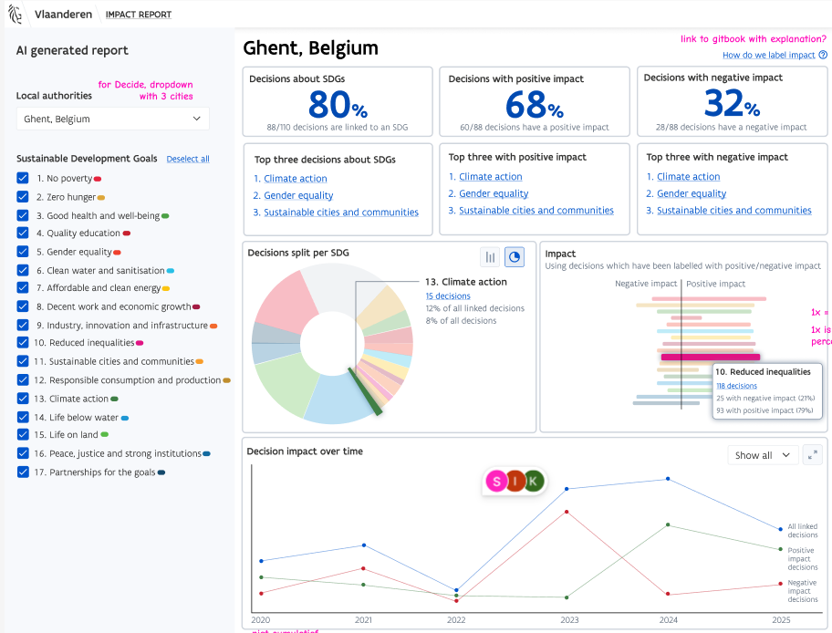
Dashboard Policy Impact Report

Slide 17
Mapping LD&L on restricted mobility zones to geo-locations
UC1

Slide 18
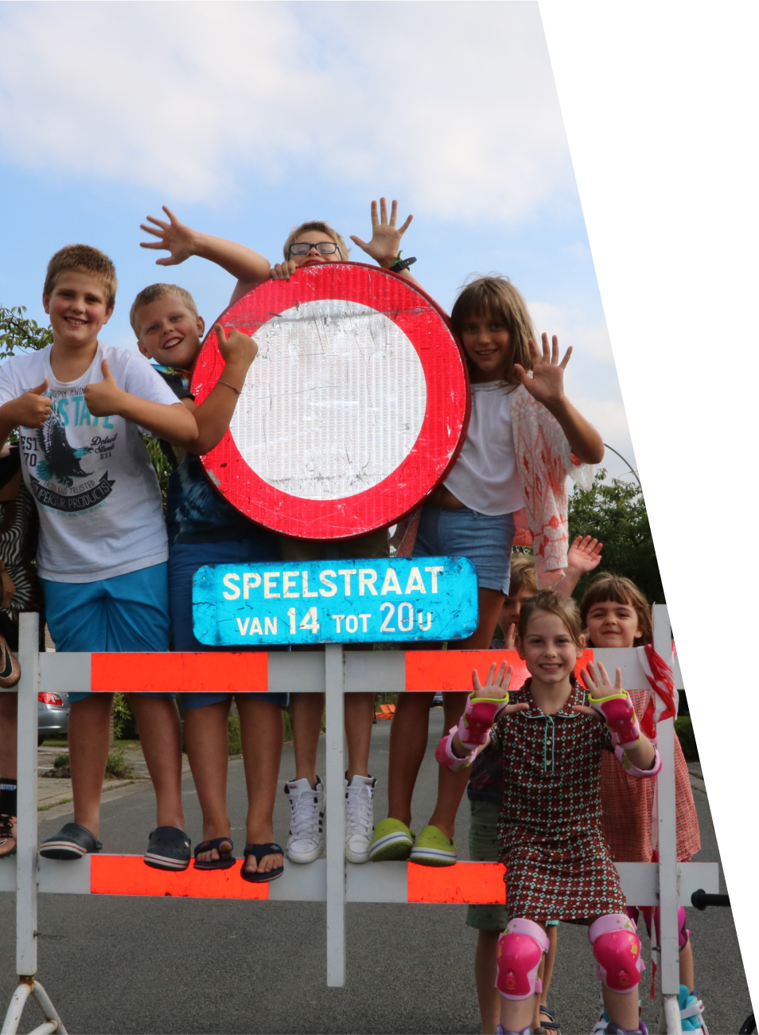
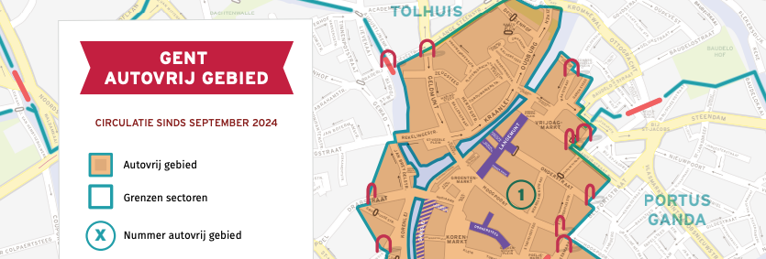
Mapping LD&L on restricted mobility zones to geo-locations for city portals
Car(e) free mobility!
F.e. cycling streets, play streets, …

Slide 19
SMART SEARCH
UC2

Slide 20
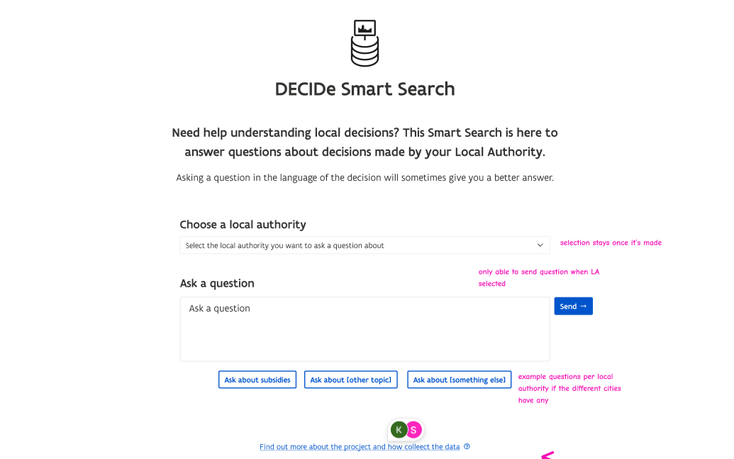
Voorbeelden

Slide 21
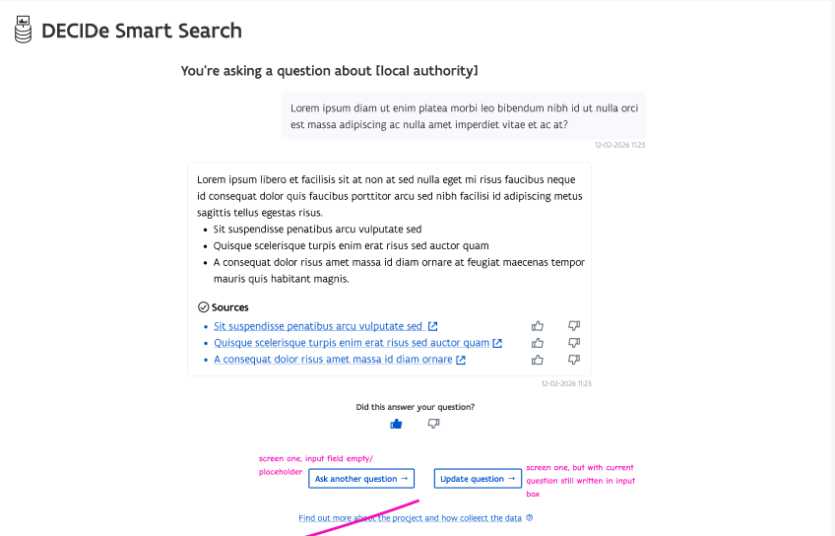

Slide 22
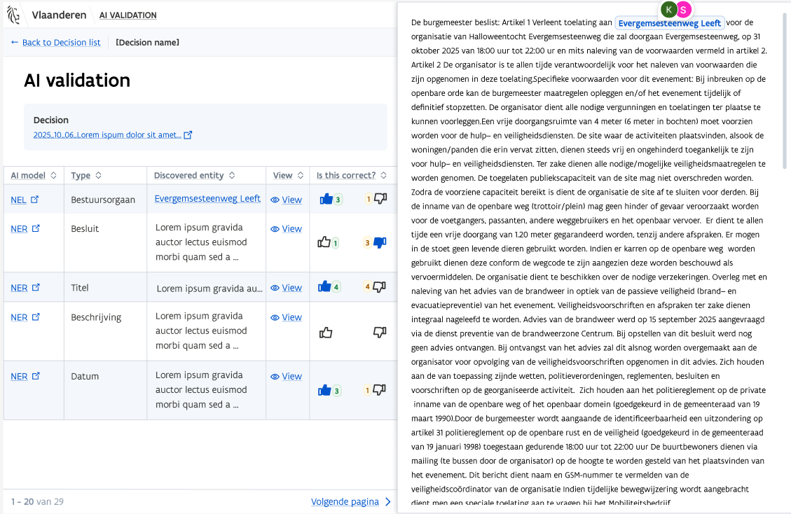
Human validation of AI results

Slide 23

Questions, remarks, advice?
veronique.volders@vlaanderen.be, stefanie.kerkhof@vlaanderen.be, daan.zwaenepoel@vlaanderen.be
Or any of the other members of the project

