Slide 1
Hydrological monitoring: Towards trustworthy Data
Janelcy Alferes, Shehabeldeen Abdelfatah, Pieter Colpaert
Trust Triggers #1
20-04-202, Ghent, Belgium

Slide 2
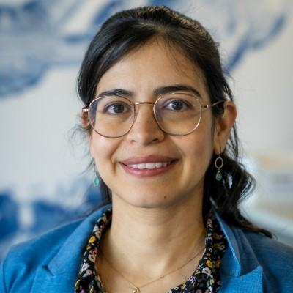





About Us
Shehabeldeen Abdelfatah
PhD student at UGent
Researcher at VITO
Specialize in Linked Data and Data Spaces
Janelcy Alferes
R&D
Project Leader Monitoring technology & Digital water at VITO
IWA Group on Instrumentation, Control and Automation (ICA)
Water Fit for Reuse digital Architecture
and Modelling Ecosystem
FWO, 2023-2027

Slide 3
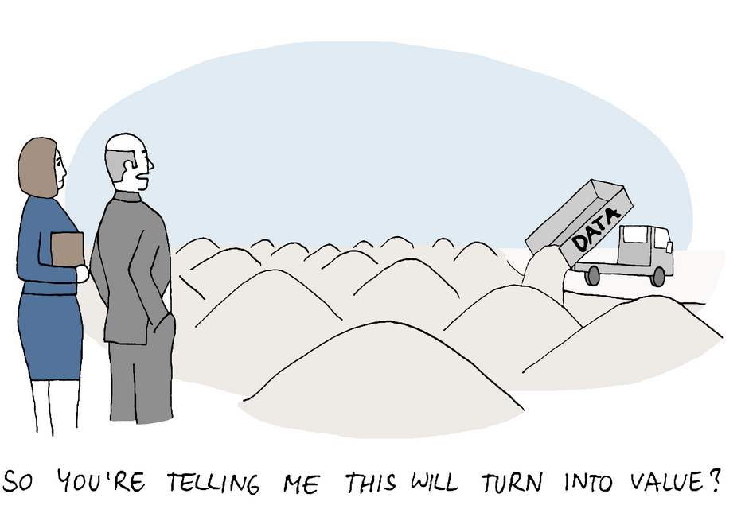
Data in the Water sector

Slide 4
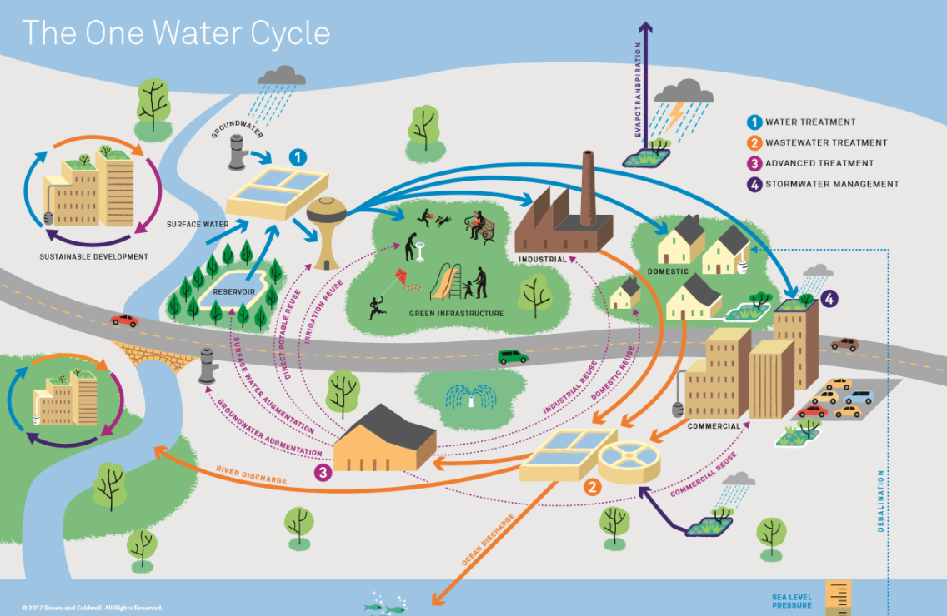

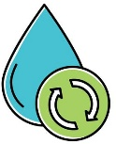
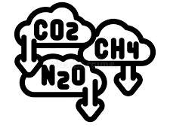


Big challenges and drivers
Water demand & Climate change
Energy
Sustainable
Challenges across the entire water cycle
GHGs
Net Zero target
Resource recovery
Contaminants of concern (CECs)
Source: Water Research Foundation (WRF)

Slide 5

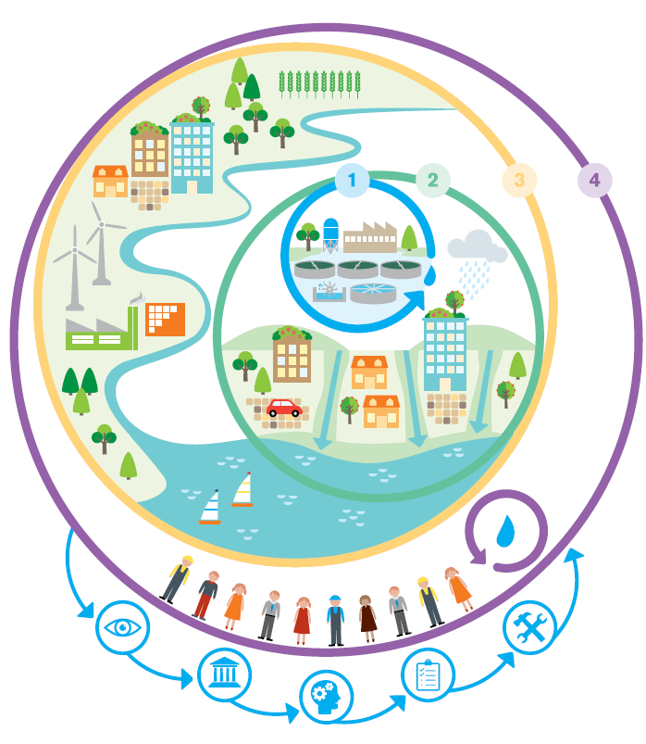

Big challenges and drivers
Complex system, suboptimal operation
Silo operations
Scattered amount of information
Data disconnected
Holistic approach, broader ecosystem
Safe & trustworthy exchange of data
Data standardization & interoperability
Models (operation & optimization)

Slide 6
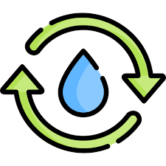
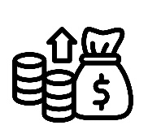
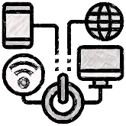
Big challenges and drivers
Transformation at all levels of water management
Efficient, robust & sustainable systems
Technologies: monitoring, ICT, modelling, AI…
From data to Intelligence
Ensure quality directives
Better management
Circular water
Increase awareness
Transformation of raw facts into actionable insights with DATA as foundation

Slide 7
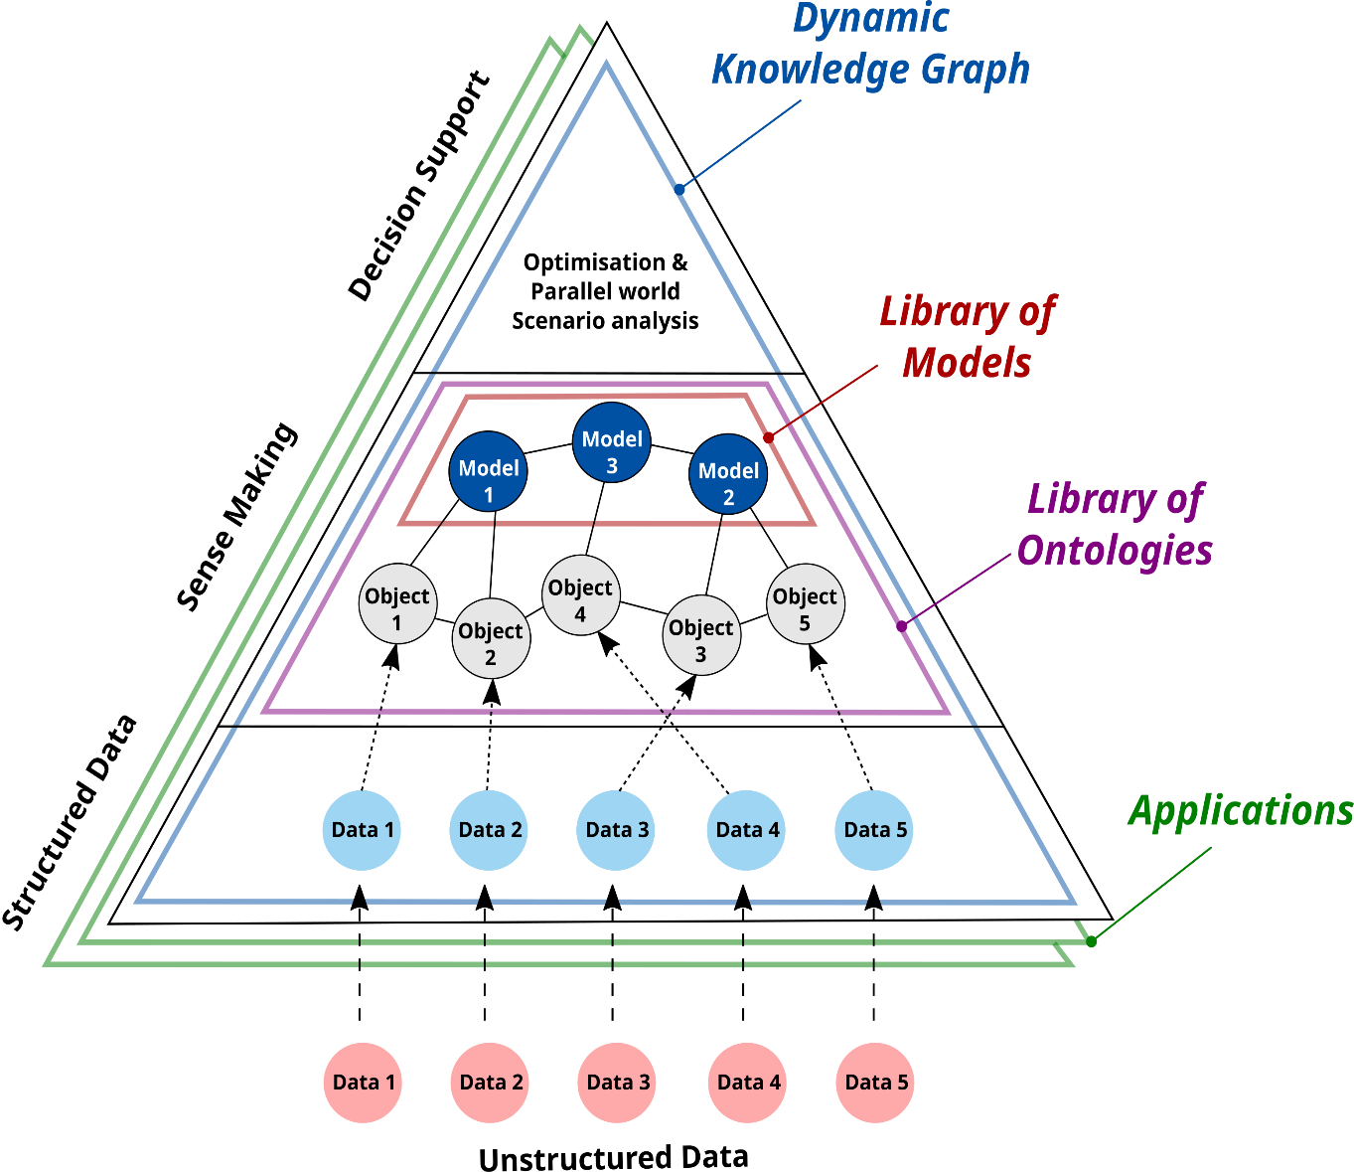

Big challenges and drivers
Bottom-up approach
Data as core element for application of data-driven solutions
Decision making
Wisdom
Insights
DATA VALUE
Knowledge
Measurements
Information
Process
Water reuse
Data

Slide 8
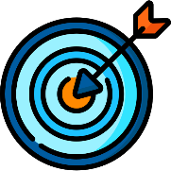

Big challenges and drivers
3
From raw information to produce actionable insights and actions
Optimization algorithms
2
Ontologies & models
Surface Water management
Tackling Salinization in industrial harbor context
Optimization water treatment plants
1
Data standardization

Slide 9

Big challenges and drivers
From raw information to produce actionable insights and actions
How do we trust the data?
How can we be sure the data isn't leading us down the wrong path?
Does more data equal more trust?
What is required towards trustworthy data?

Slide 10
Big challenges and drivers
Make data accessible, interoperable and actionable.
Ensure consistency, reliability, security, and usability of the data towards water reuse & circularity.
From raw information to structured and interoperable data
1
Data standardization

Slide 11
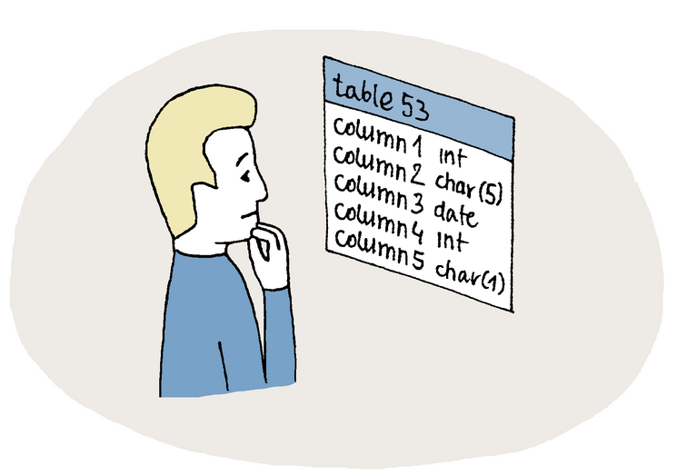
From unstructured to structure data

Slide 12
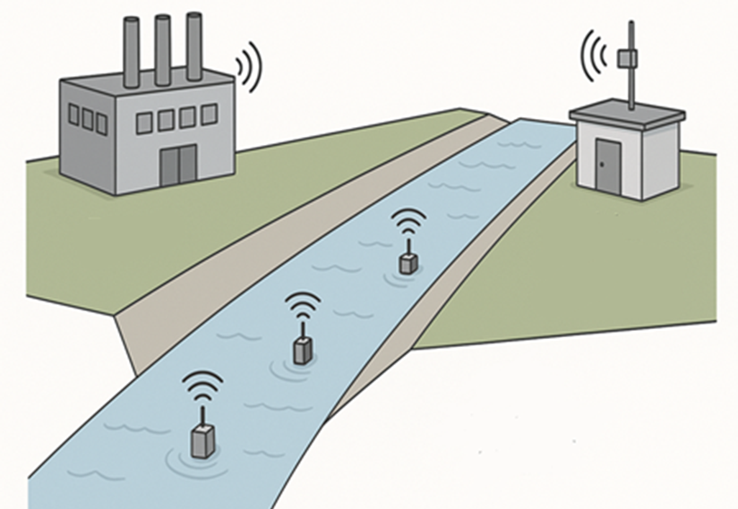
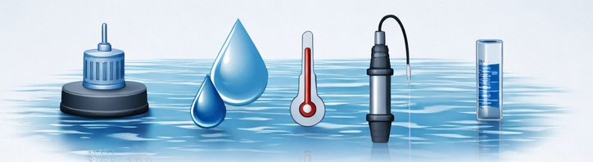
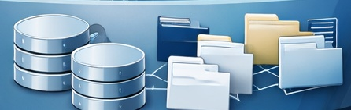
Data sources
Multiple data sources (different organizations & even countries) describe a single body of water
Each source comes with its own unique format, structure, and semantics (even language!).
How do we take advantage of all available data sources at the same time? (query, visualize, calculate, predict)
Can we utilize real-time data?

Slide 13
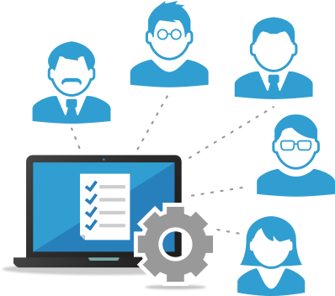
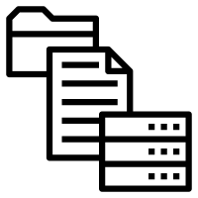

The solution … Linked data
Unstructured Data
Structured Data
Multiple data sources
Available for users/uses
Transformations
How can linked data lead to more trust?
1
2
3
4
5
Verifiable Provenance
Semantic
Context
Corroboration through Interconnectivity
Transparency
Reduced Human Intervention
Uses URIs for subjects, objects, and relationships
Built on top of Ontologies. By linking a data point to a globally defined term, everyone agrees on the exact meaning
If Dataset A links to Dataset B, & Dataset C also links to Dataset B to confirm the same fact, the "weight" of that truth increases
follows Open World Assumption (OWA). information it has might be incomplete and provides links to find the rest
manual "ETL" (Extract, Transform, Load) replaced by Federated Queries (using SPARQL). Data is queried directly from the source in real-time.

Slide 14
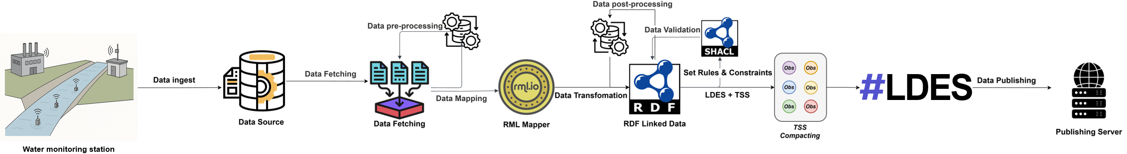
What if the data we have is not Linked Data?
How to transform traditional (discrete) data into linked data
  We build pipelines to transform traditional (discrete) data into linked data
  Pipelines work in an automated fashion.
  Human intervention is needed to adjust for schema design/changes
2
1
Publishing Linked Data

Slide 15
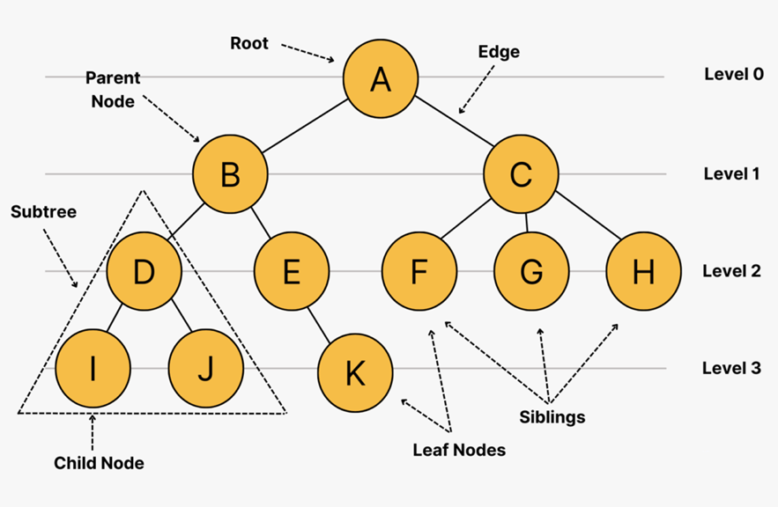
What we did to improve upon traditional linked data
1
Linked Data Event Streams (LDES)
Data is published as an append-only stream of immutable "events“ appended to existing data
Built-in Versioning (History)
Published in fragmented feeds, which makes it cheaper to query
Efficient synchronization. A client can "subscribe" to the stream and know exactly where they left off, catching up on only the missing events.
Fragmented tree

Slide 16
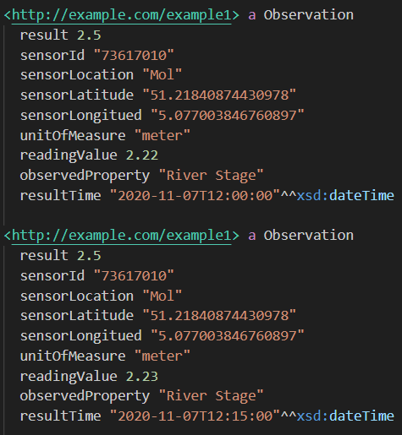
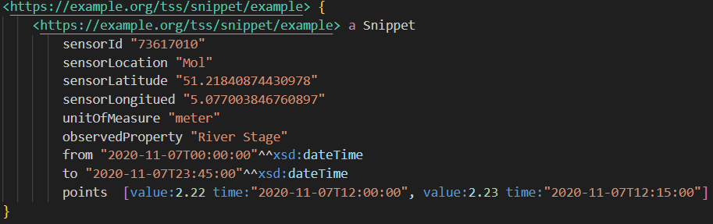
What we did to improve upon traditional linked data
RDF Time Series Snippets (RDFTSS)
Data is compressed by separating redundant metadata from sensory readings
Significant reduction in ingest/recall size/time
Native support for data analysis tools
2

Slide 17
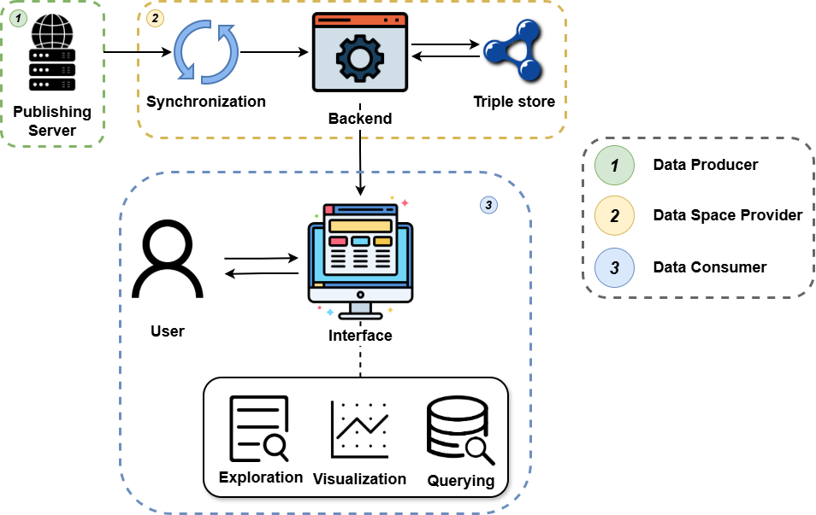
How to consume linked data
Develop a Linked Data consumption-centric system.
Data is offered in multiple forms (LDES, LDESTSS, and CSV)
Decision support is provided in the form of querying, visualization, and forecasting.

Slide 18
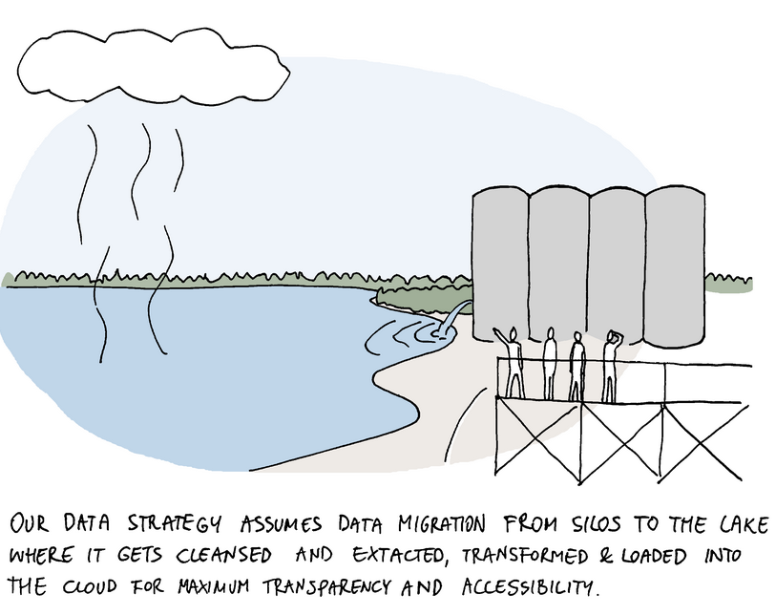
Case Studies

Slide 19
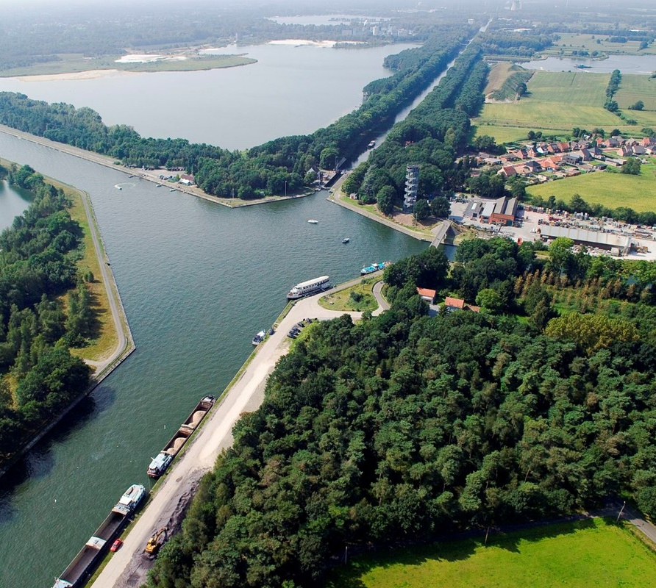
Dessel–Kwaadmechelen canal
We started by monitoring two attributes: stage and discharge.
High-resolution historic data from 2021 to present.
Data obtained through Hydrologisch InformatieCentrum (HIC).

Slide 20
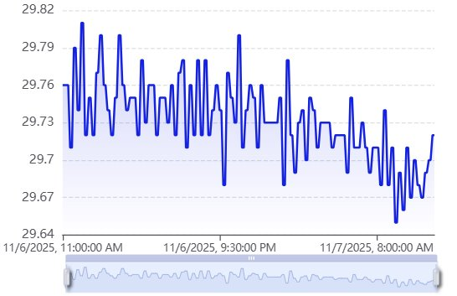
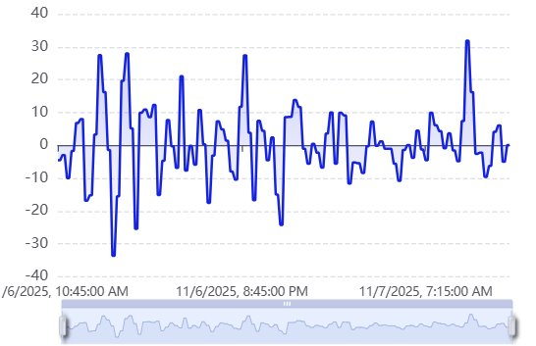
Dessel–Kwaadmechelen canal use case
Examining a selected window in June 2025, we noticed spikes in water discharge. This may indicate a change in the water level, probably caused by precipitation.
Stage
Discharge

Slide 21
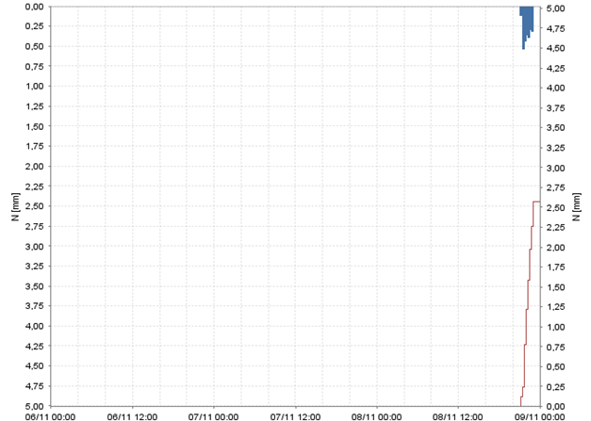
Dessel–Kwaadmechelen canal usecase
Examining a selected window in June 2025, we noticed spikes in water discharge. This may indicate a change in the water level, probably caused by precipitation.
Examining precipitation data, we noticed that the spike happened during a dry spell, eliminating prior conclusion.
The conclusion, lock operations lead to the discharge spikes
Stage
Discharge
Precipitation

Slide 22
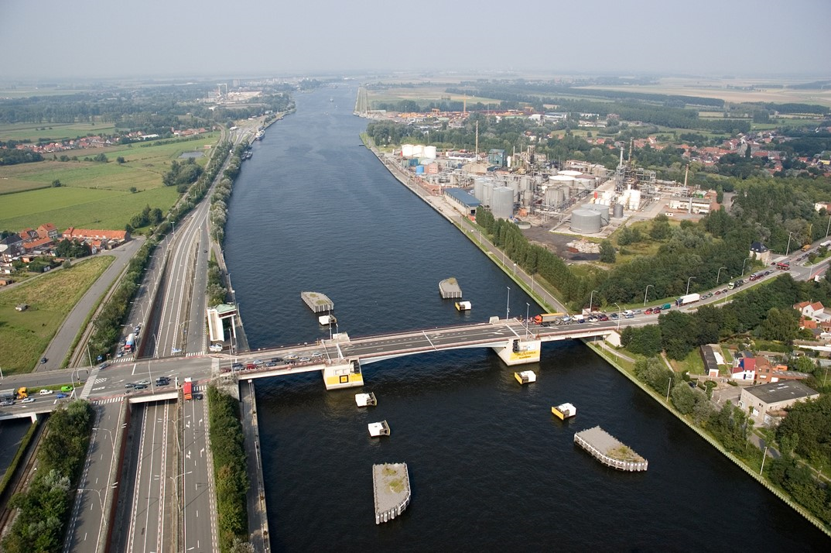
Gent-Terneuzen Canal
We monitor canal conductivity levels through four sensors.
High-resolution historic data from 2021 to present.
Data obtained through Vlaamse Milieumaatschappij and .

Slide 23
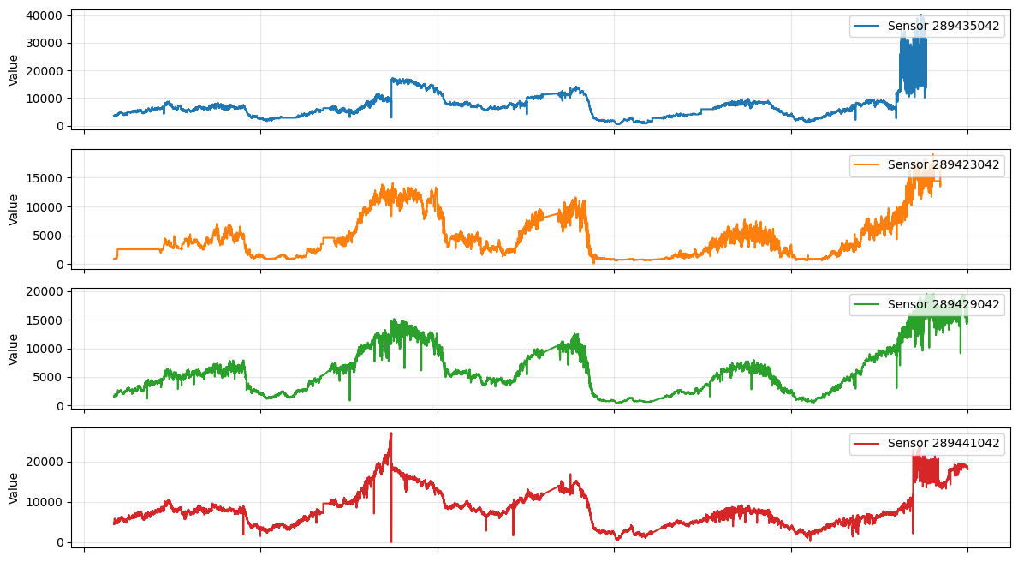
Gent-Terneuzen Canal use case
There's a clear long-term seasonal pattern, conductivity peaks in summer/autumn and drops in winter, repeating annually. This is typical for canals — lower rainfall and higher evaporation concentrate salts.

Slide 24
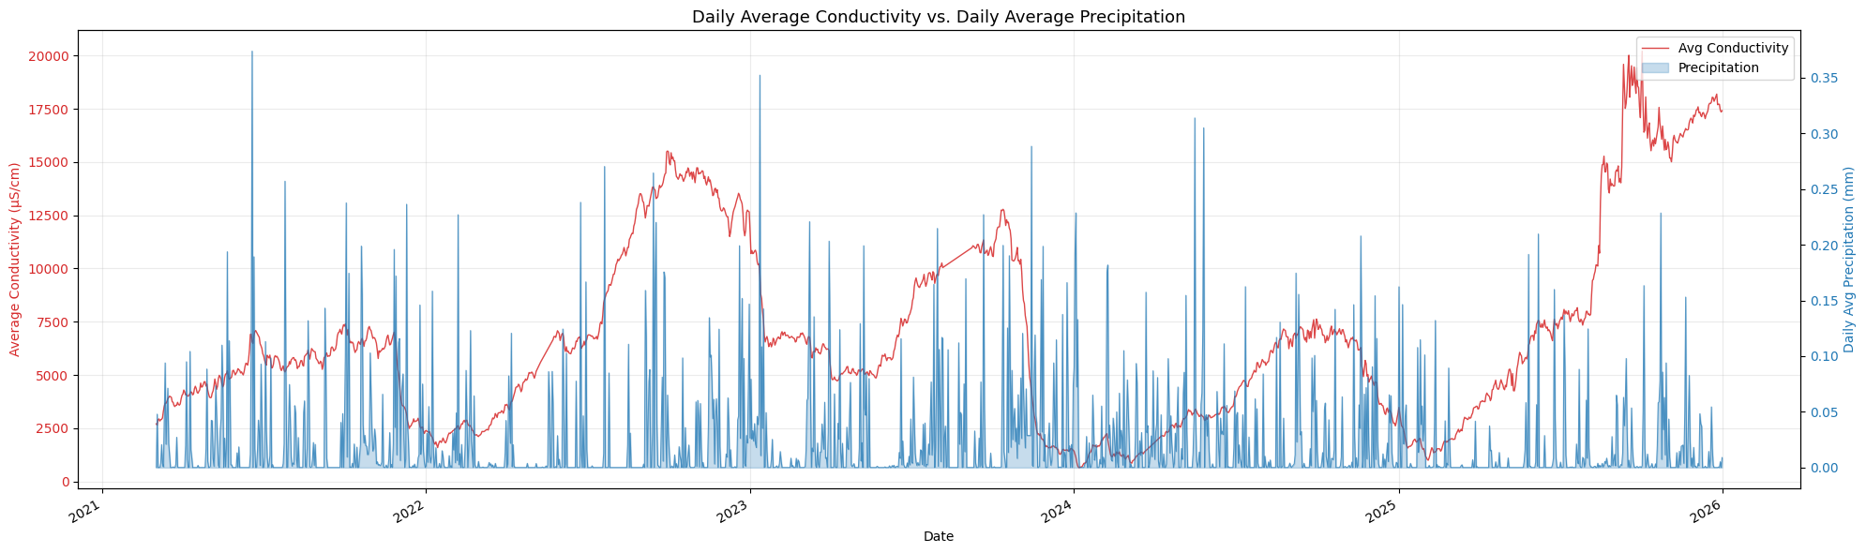
Gent-Terneuzen Canal use case
Examining precipitation data, we notice that it has no noticeable effect on the canal’s conductivity.

Slide 25
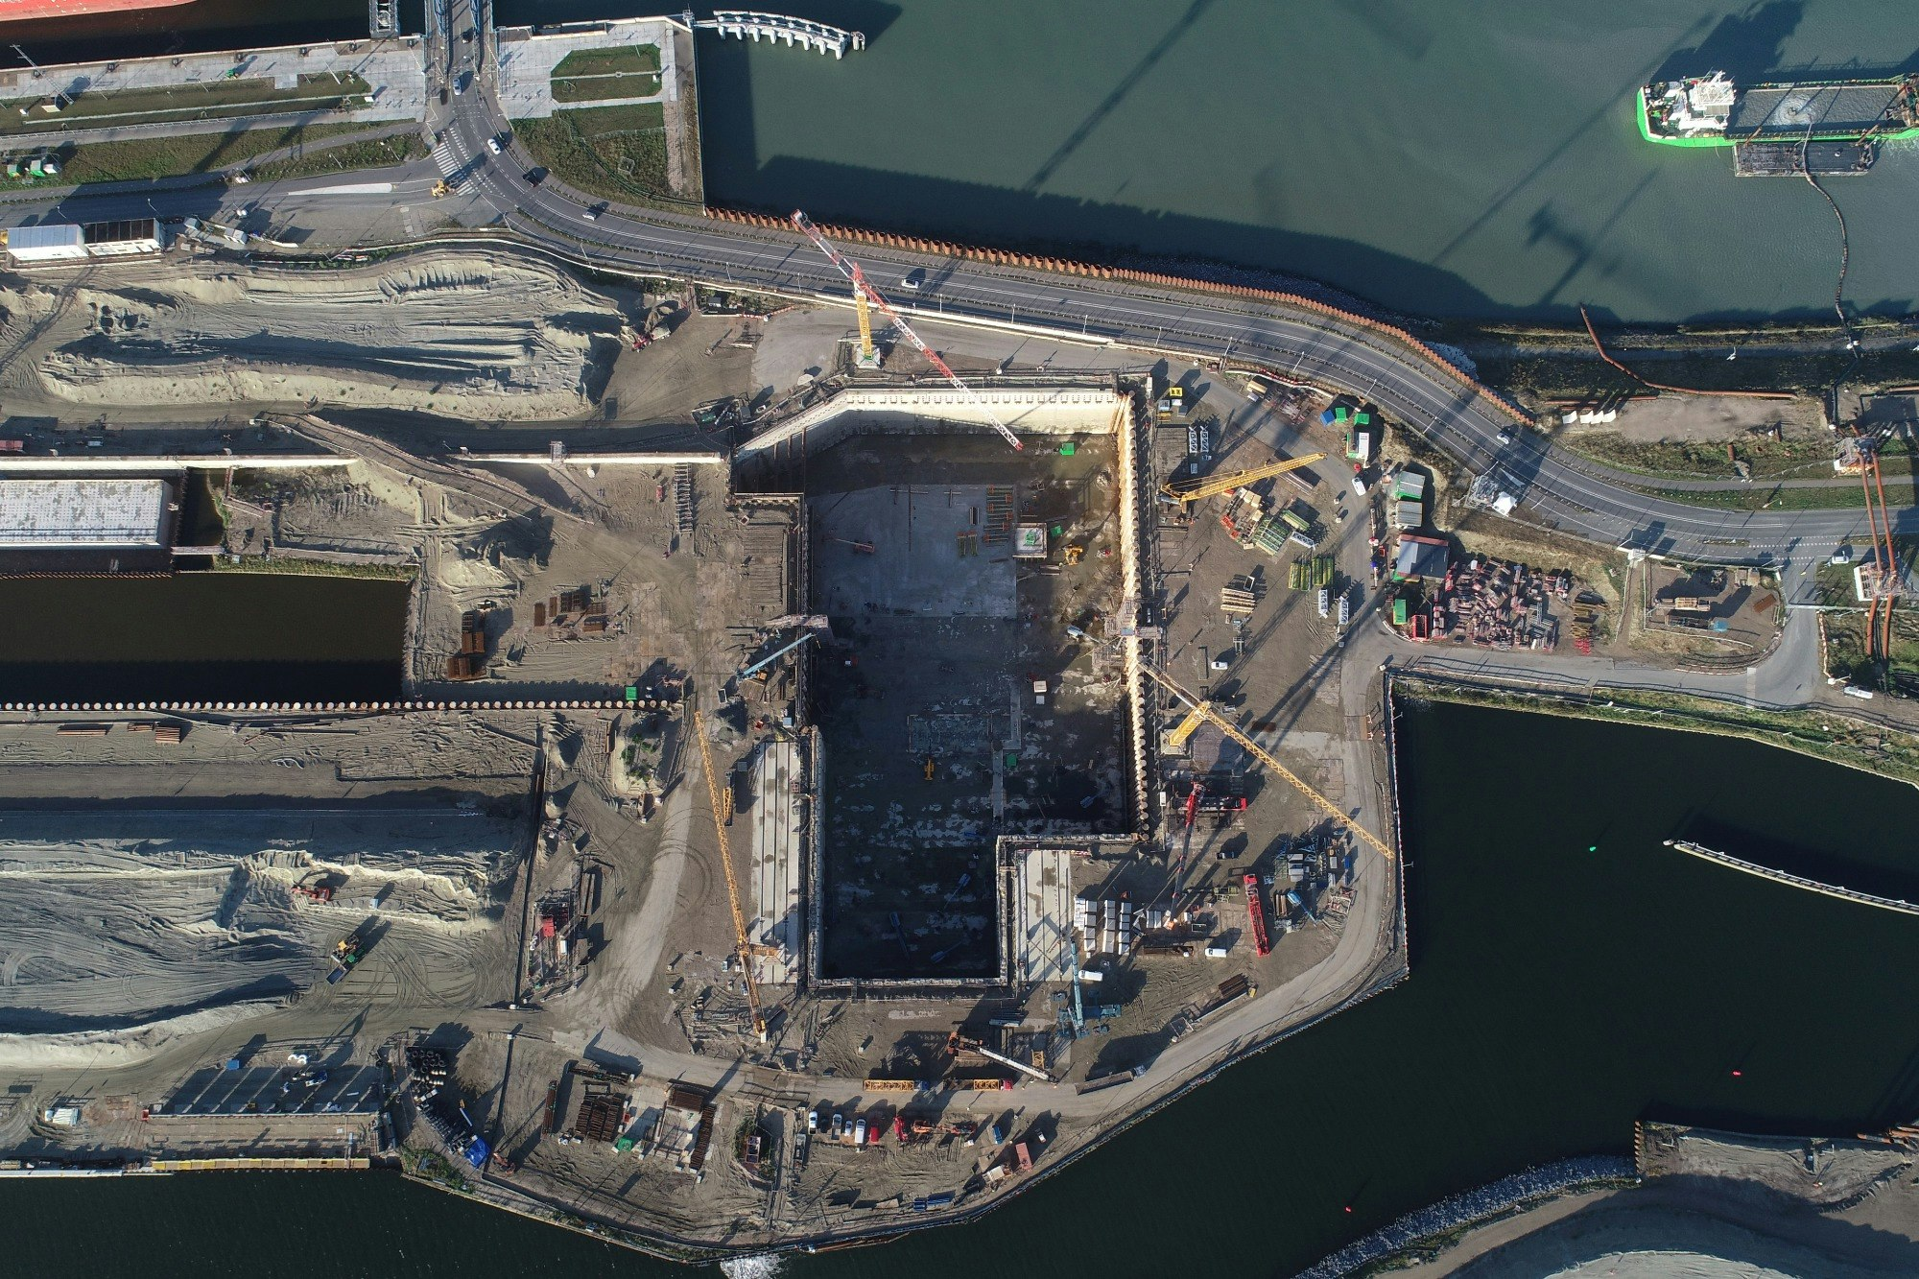
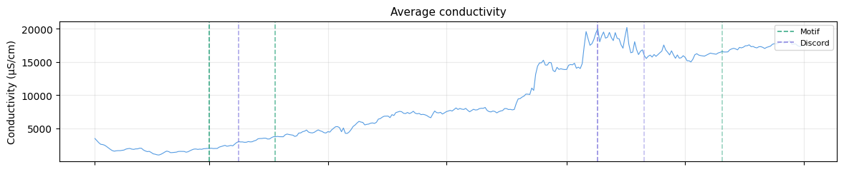
Gent-Terneuzen Canal use case
The conductivity value is higher on average in 2025 onward, suggesting recent behavior is more variable and harder to match to historical patterns.
The first recording of a conductivity value measuring over 10000 µS/cm in the year 2025 was in August, same month the new third lock became operational. Link

Slide 26
What we learned from the use cases
Having data ≠ Sufficient data
There is a need to have

Slide 27
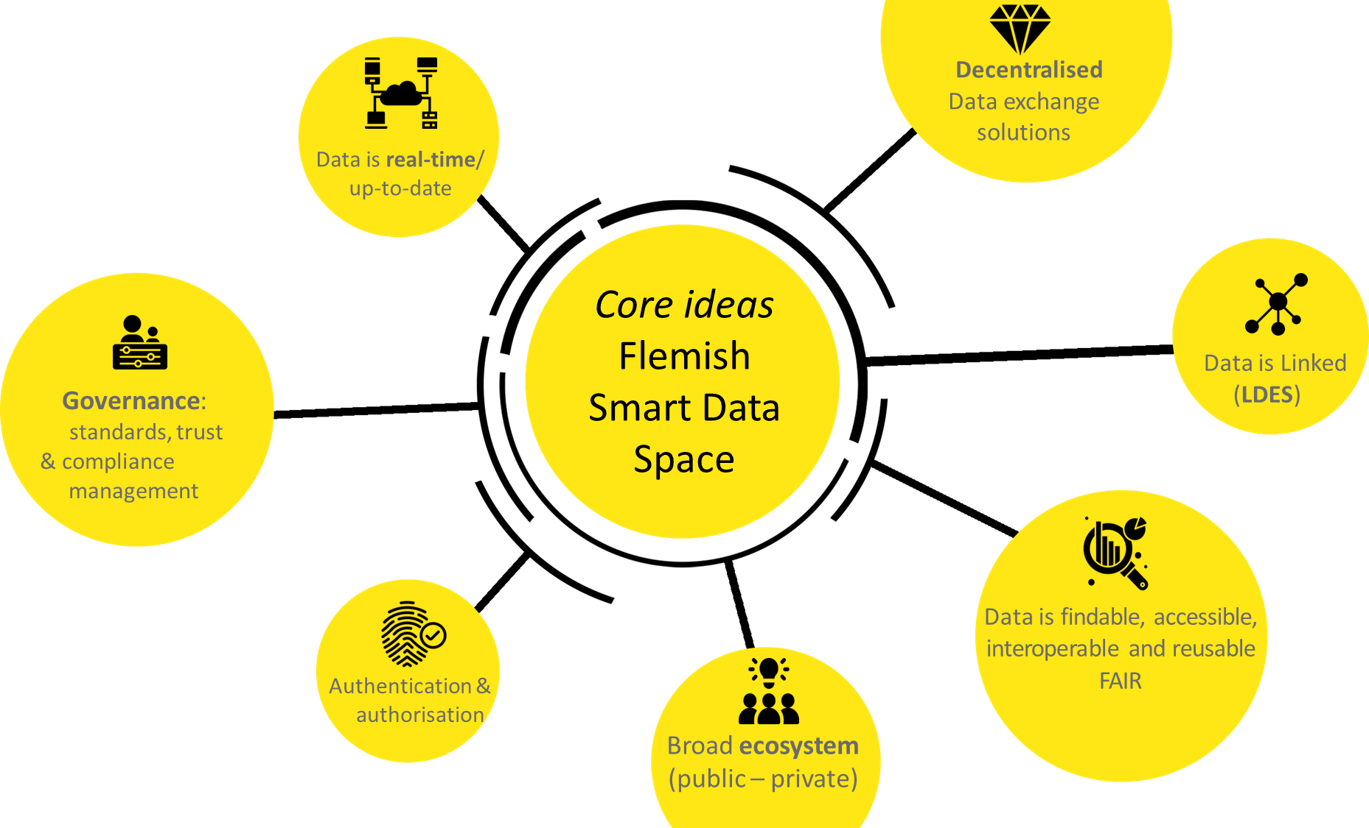
Flemish smart data space
Smart Mobility
Water Management (flood, drought)
Agri-food
Environmental Monitoring

Slide 28

Take home message
Data can accelerate a successful transition towards efficient, & sustainable water systems.
“Good” and “enough” data leads to trust in data-driven decision making
Data standardization is paving the way towards Trustable use and exchange of data, facilitating interoperability and data solutions
“without data, there is no information; without information, we know nothing; and a system that embeds no knowledge can not be intelligent” (Therrien et al., 2020)

Slide 29
Thank you!
Janelcy Alferes
(janelcy.alferescastano@vito.be)
Shehabeldeen Abdelfatah
(shehab.ayman@vito.be)

